Slide 1
Android Study Jams
Organizer Guide

Slide 2

What are Android Study Jams?
Android Study Jams are community-organized study groups for people to learn how to build Android apps using an online training course*
* Note: One session will utilize Kotlin Koans material

Slide 3
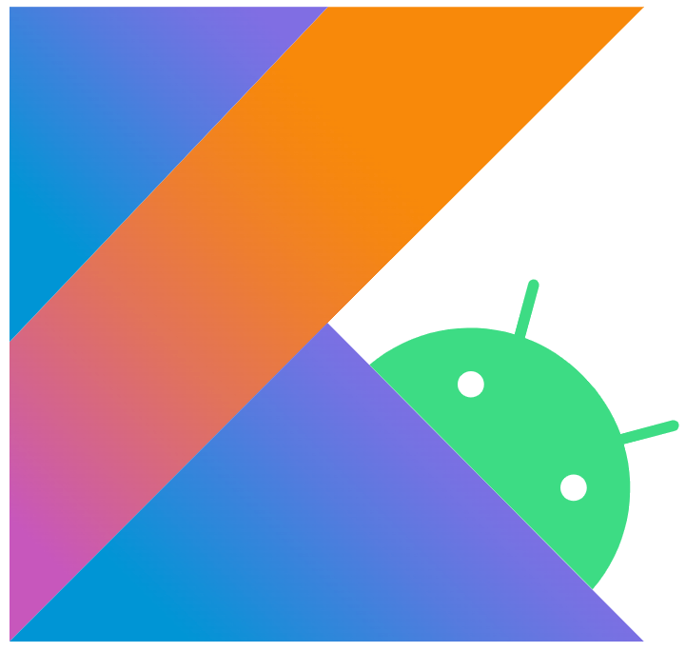
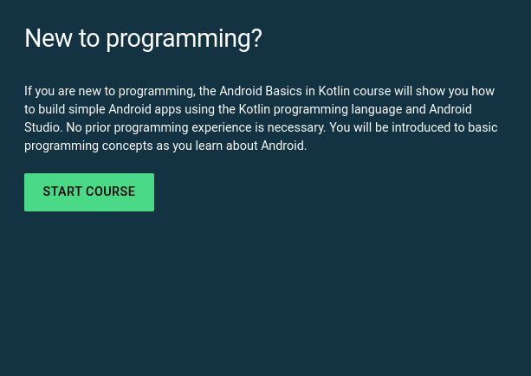
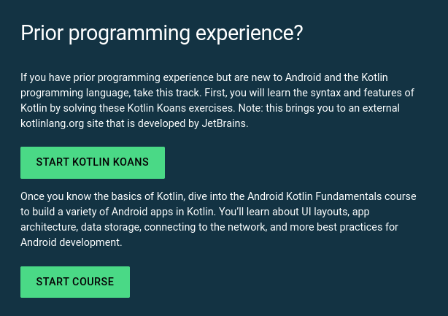
Where to start?
Choose a track that’s appropriate for you and your community
New to programming?
Have prior programming experience?
Start here
Start here
This work is licensed under the Apache 2.0 License

Slide 4
New to Programming Track
Learn the basics of building Android apps with the Kotlin programming language and develop a collection of simple apps to start your journey as an Android developer!
Pre-requisites
Basic computer literacy
Basic math skills
Curriculum used
Android Basics in Kotlin Course (here) with ten pathways currently available! More to come.

Slide 5
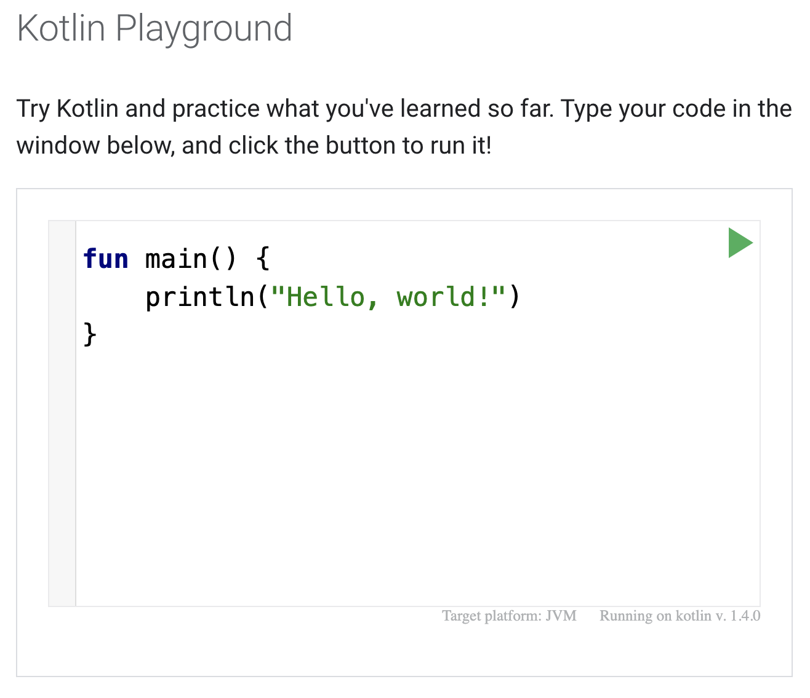

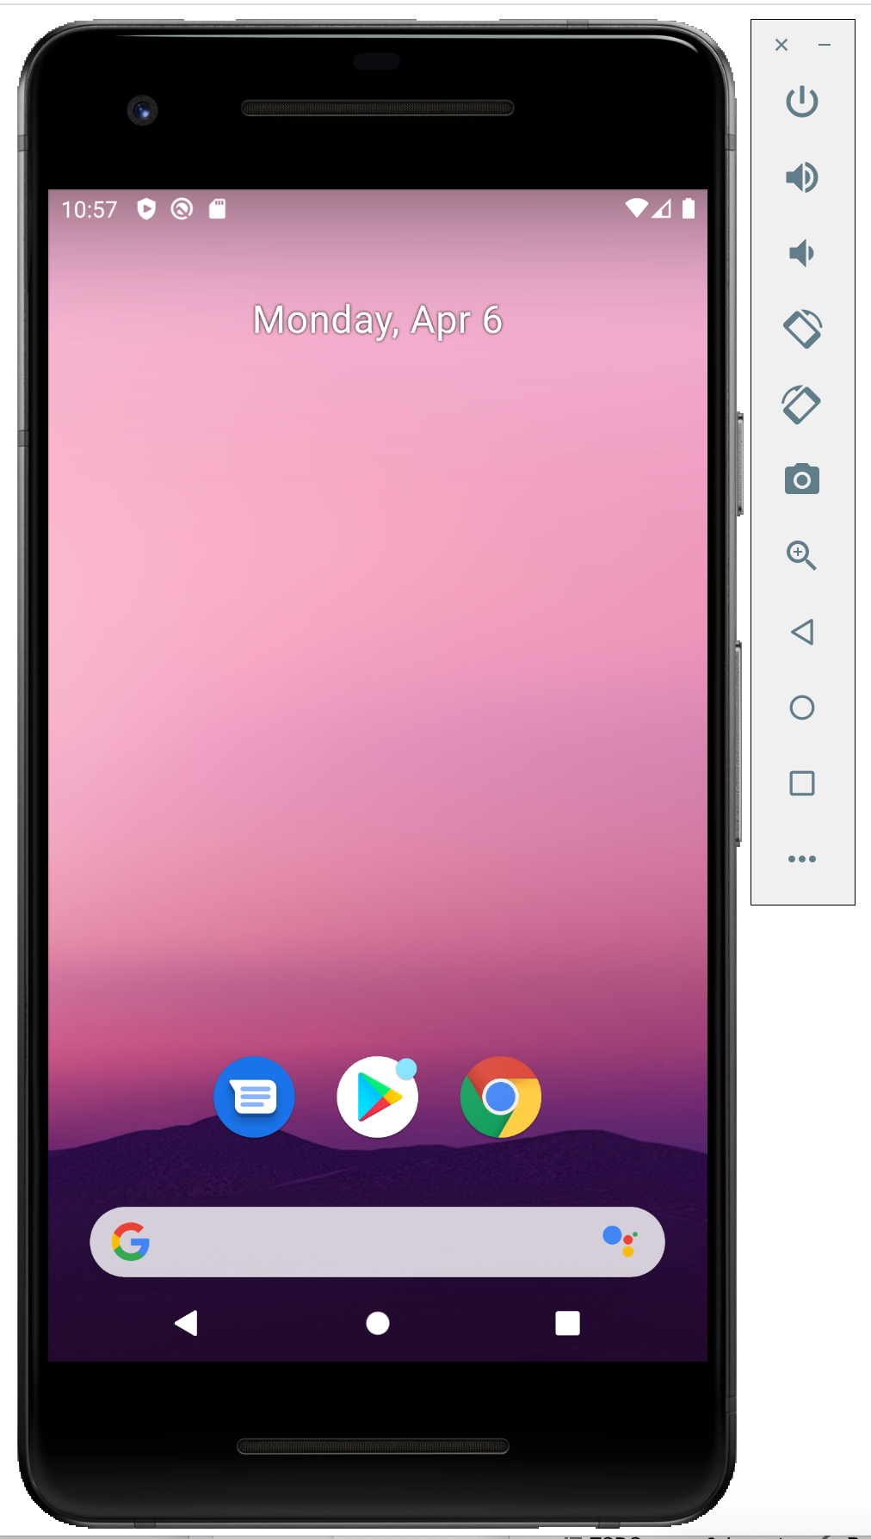

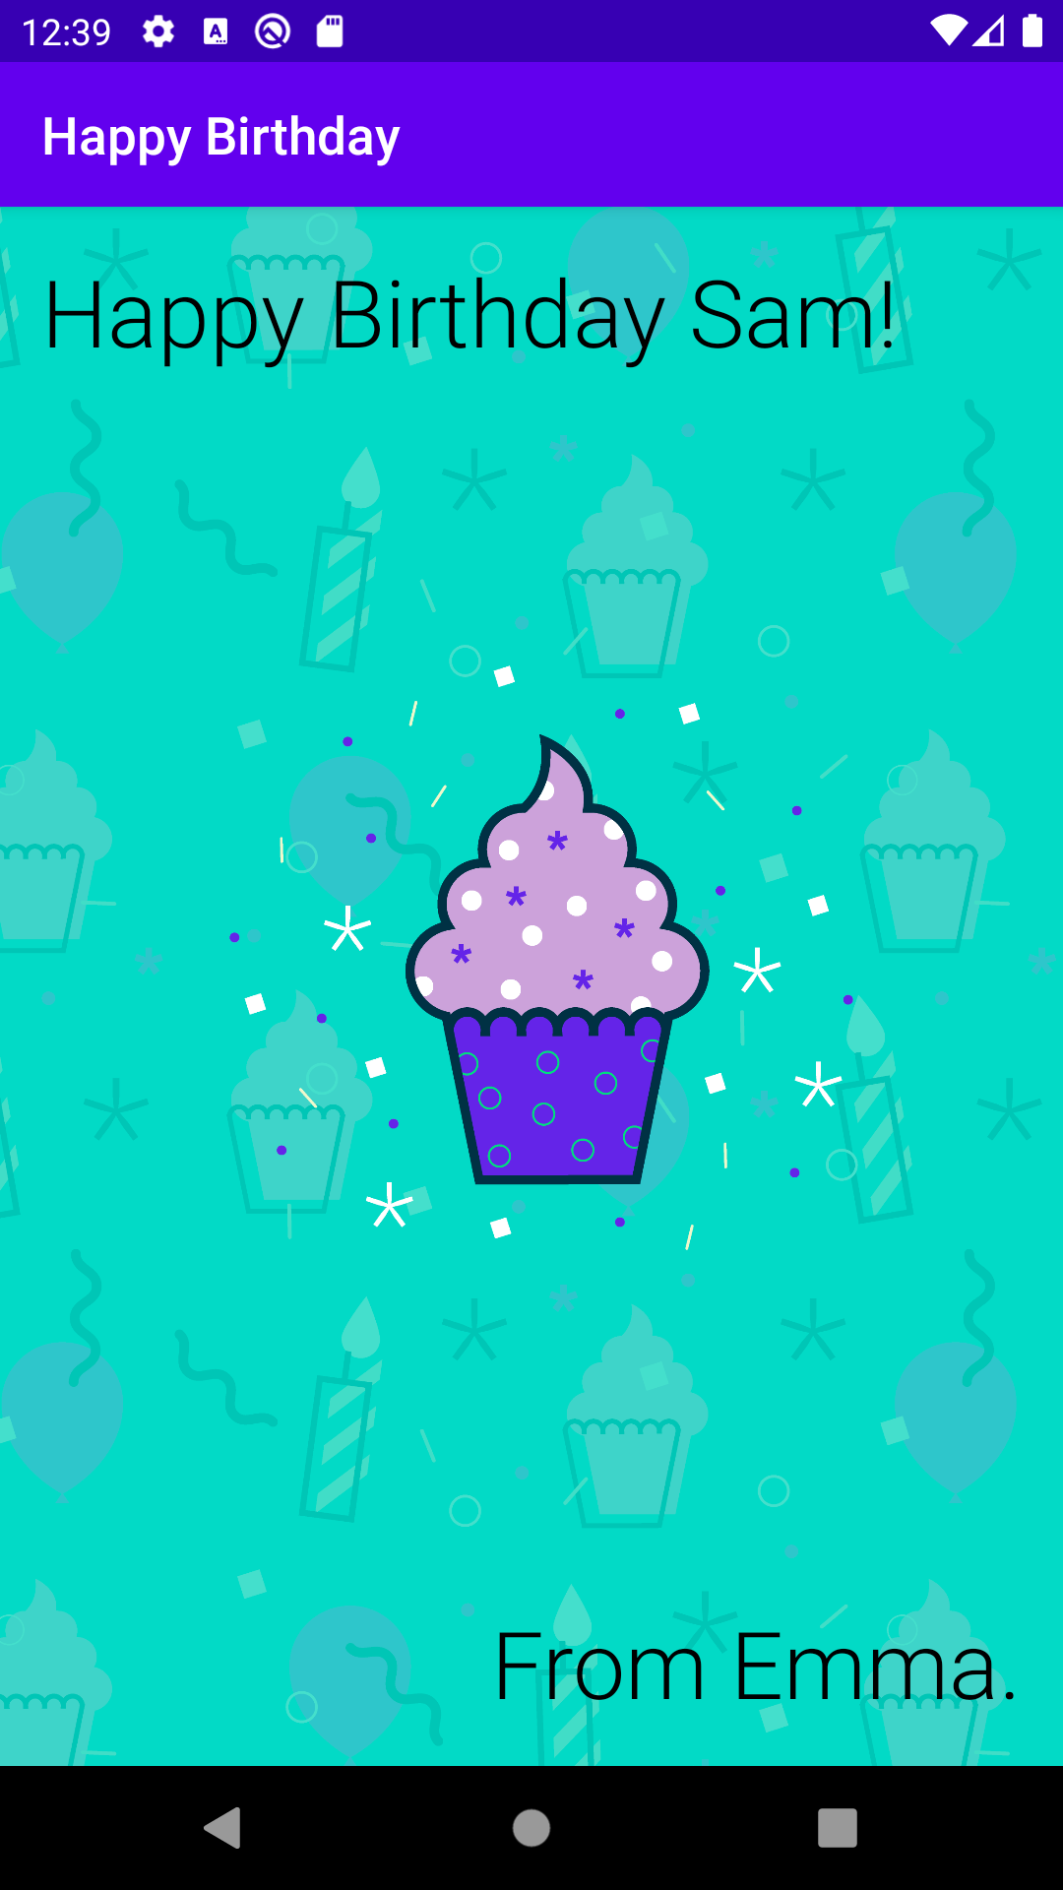

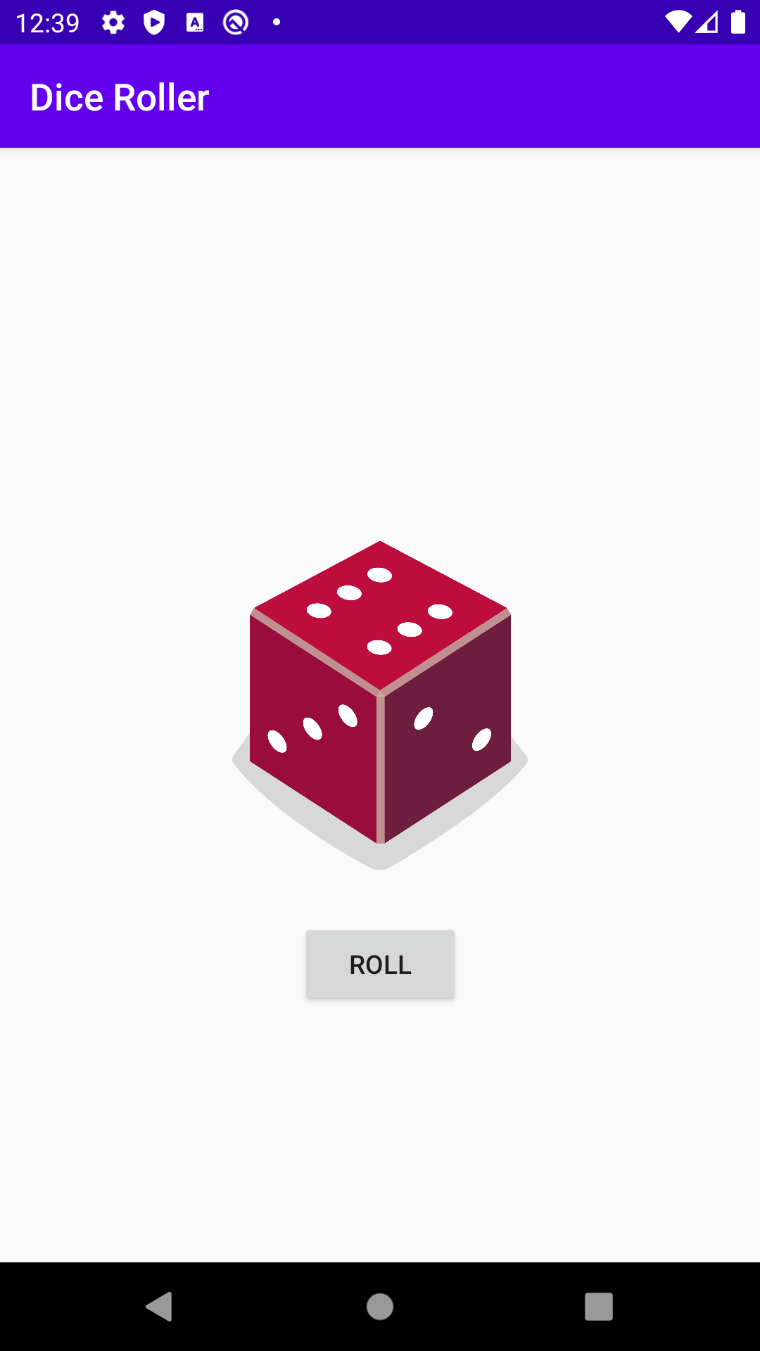


New to Programming Track
Badges
Earn badges
at the end of each
pathway!
What will you learn?
1
Introduction to Kotlin
Learn to code in Kotlin, a modern programming language that helps developers be more productive.
(1 hour)
2
Create your first Android app
Learn to create and run your first Android app in Android Studio.
(1 hour)
3
Build a basic layout
Learn the basics of layouts in Android by creating your very own birthday card app!
(1 hour)
4
Add a button to an app
Learn how to use classes, objects, and conditionals to create an interactive dice roller app.
(3 hours)

Slide 6
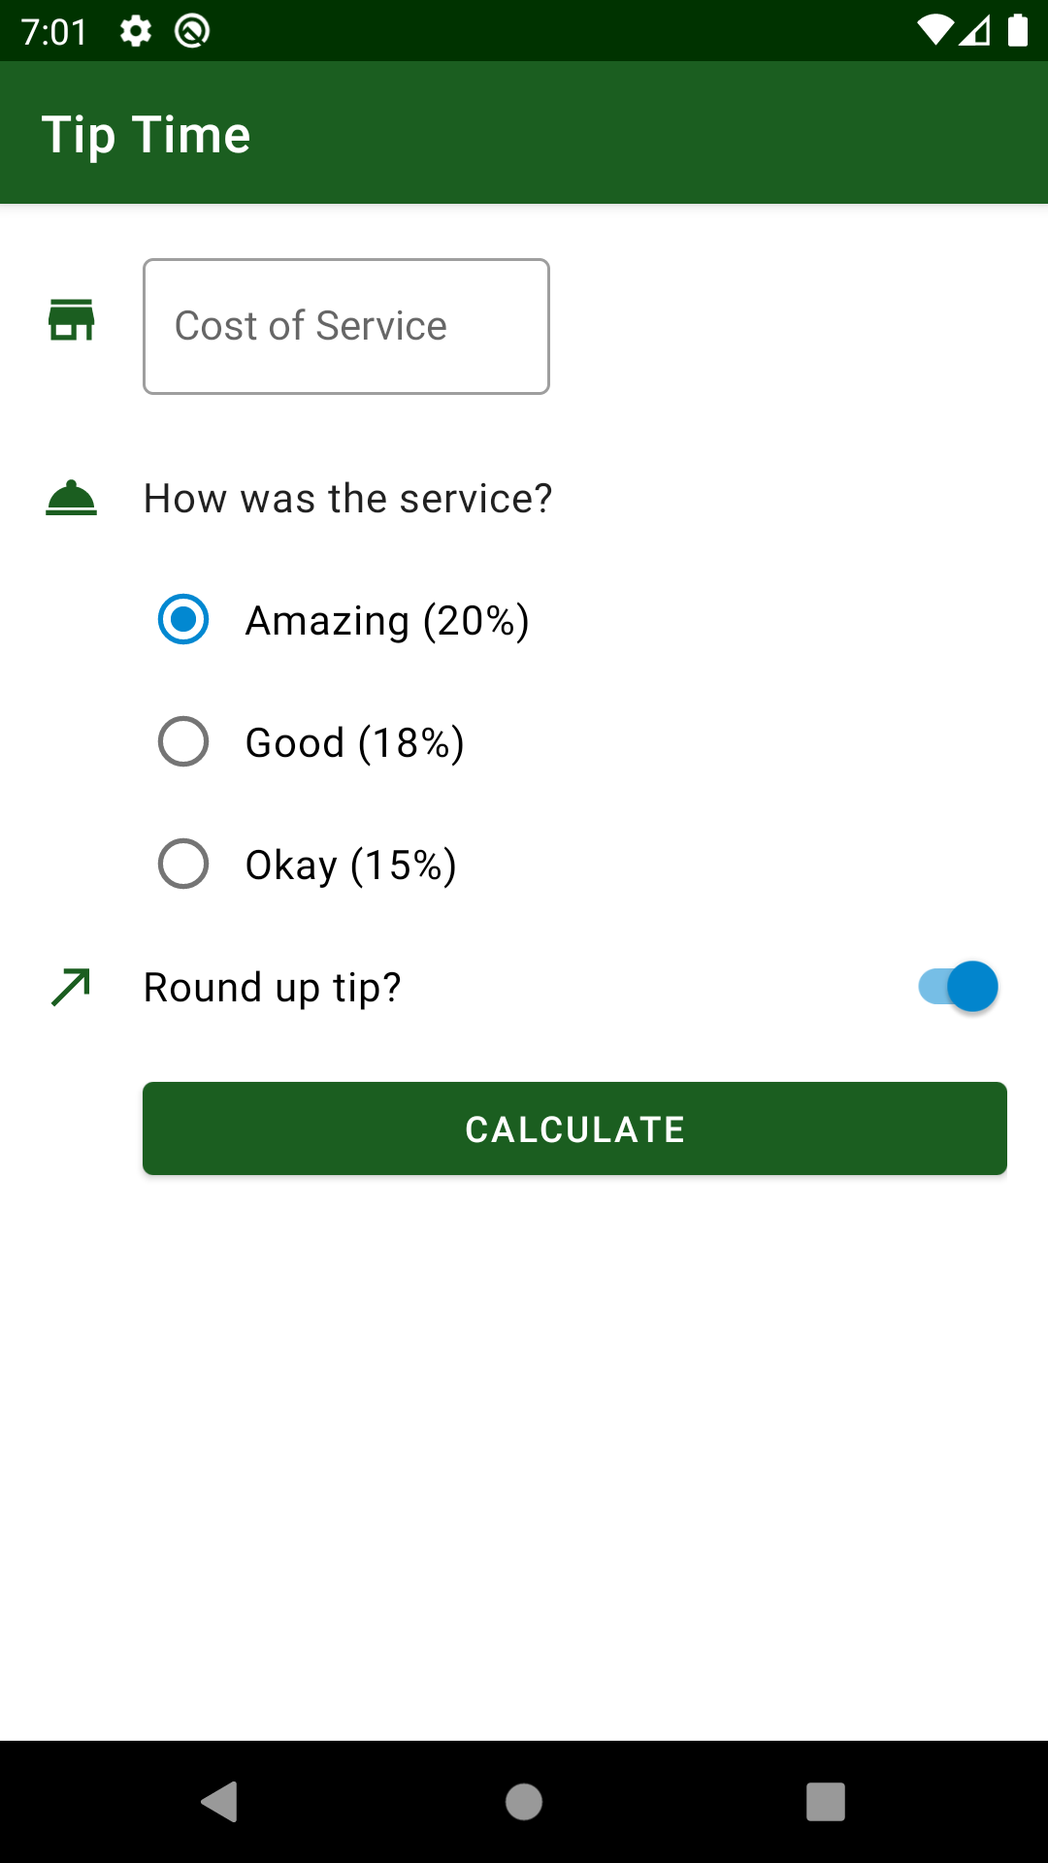

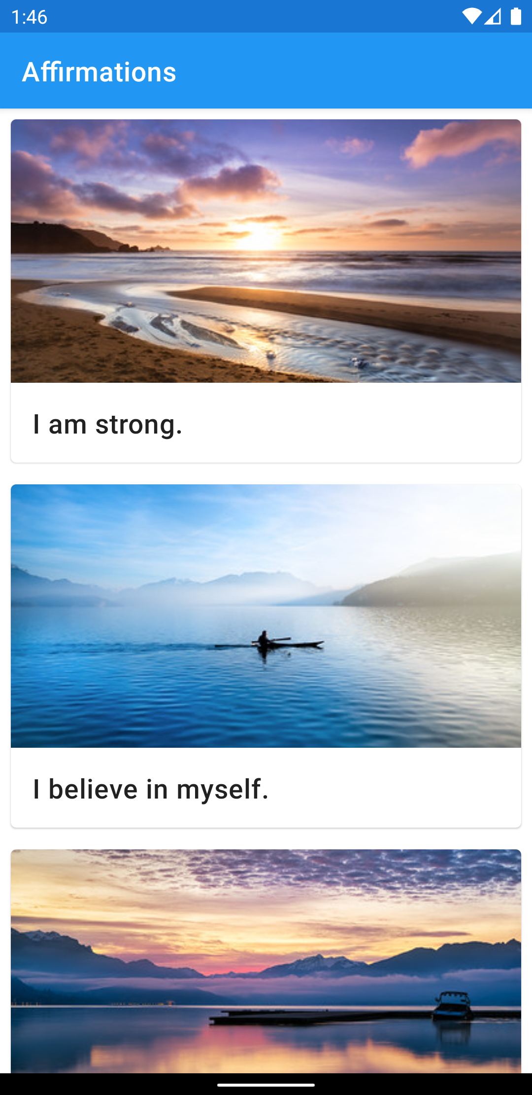

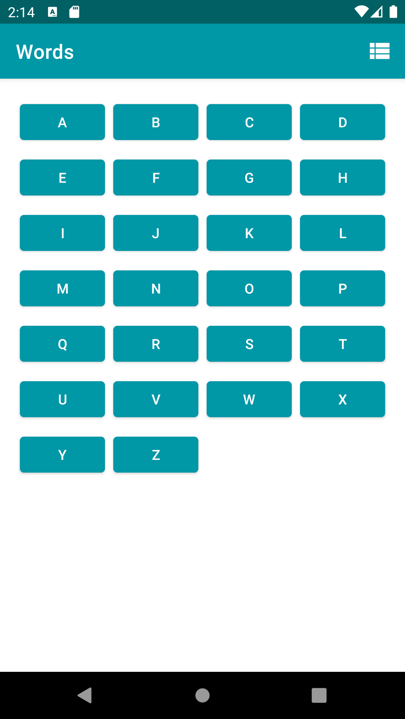

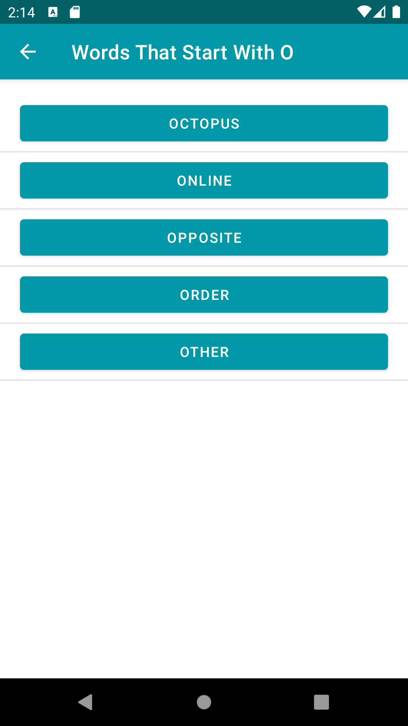
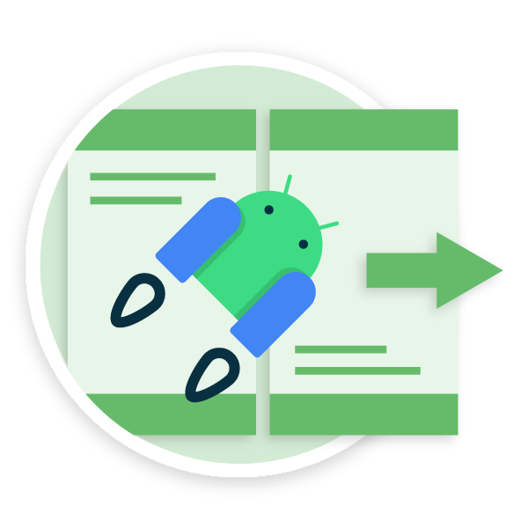
New to Programming Track
What will you learn?
Badges
5
Get user input
Learn how to get user input within an app by building a tip calculator app.
(3 hours)
6
Display a scrollable list
Learn how to display a list of text and images in an app.
(3 hours)
7
Navigate between screens
Add another screen to your app by adding a second activity.
(3 hours)
8
Intro to Navigation Component
Learn how the Jetpack Navigation component makes it easier to manage navigation within your app.
(2 hours)

Slide 7
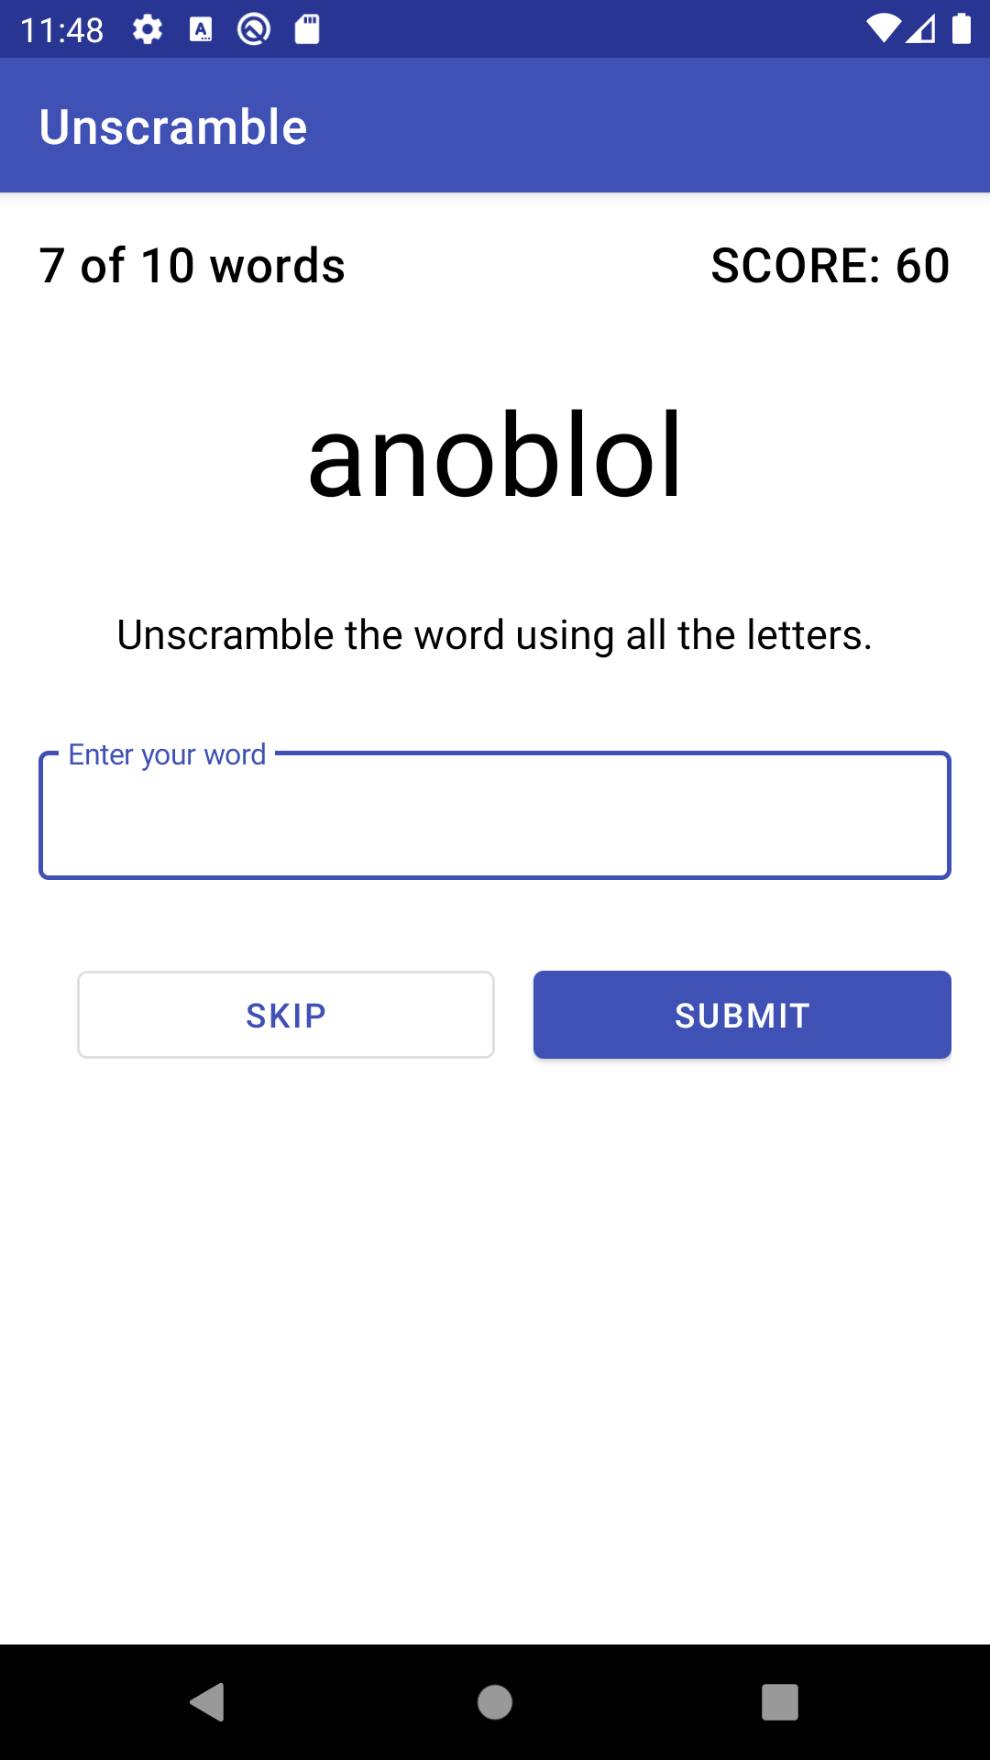
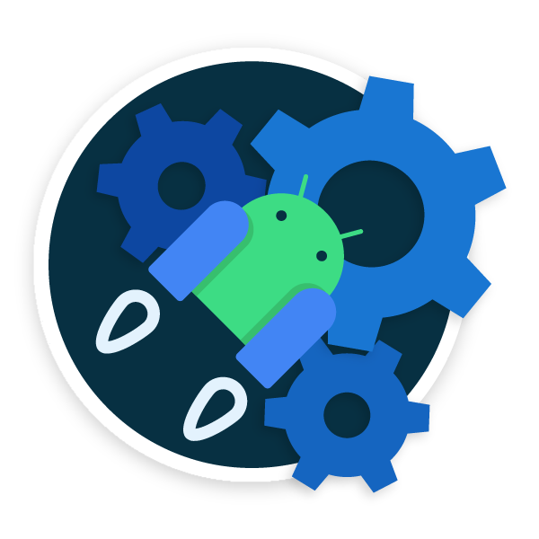
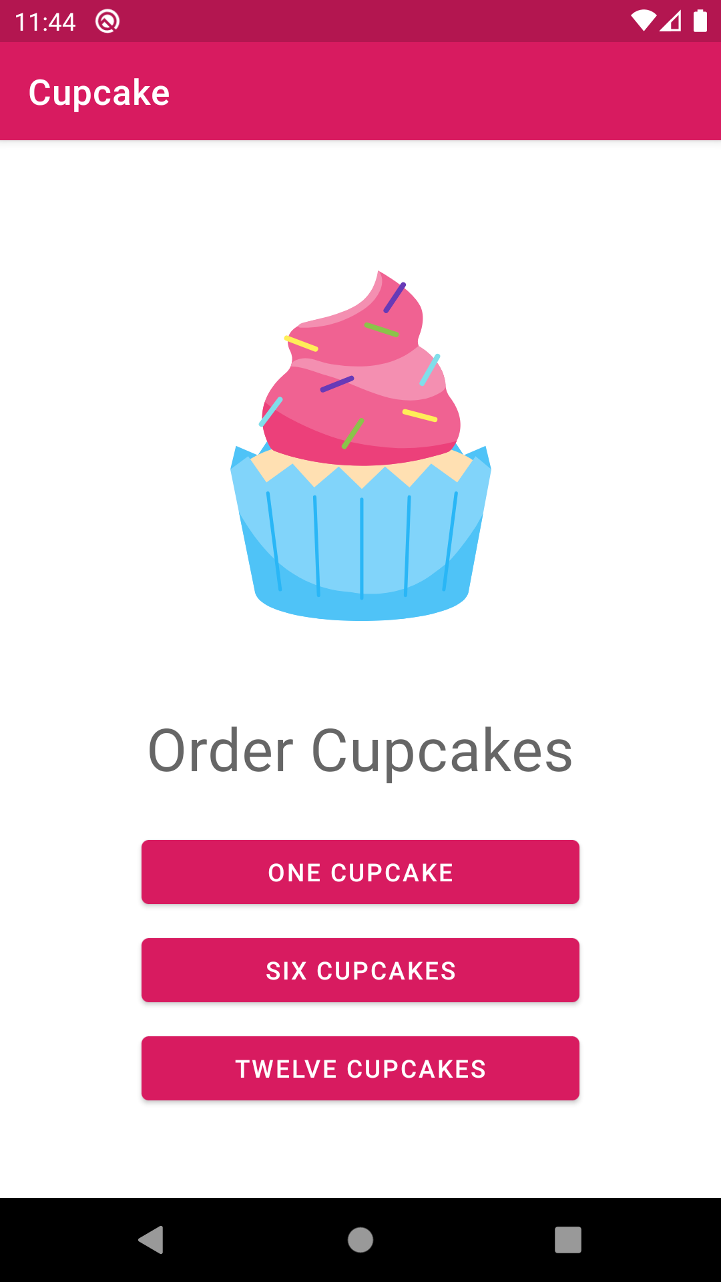
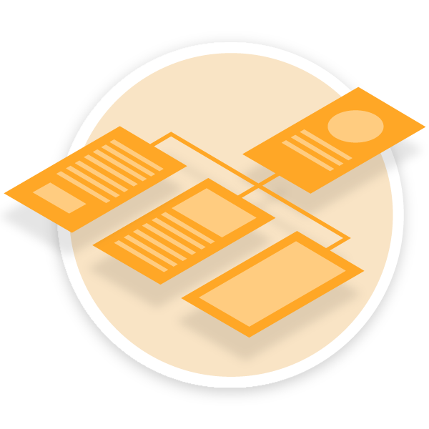
New to Programming Track
What will you learn?
Badges
9
Architecture Components
Learn good app architecture principles by building a game app to unscramble words.
(3 hours)
10
Advanced
navigation examples
Combine what you’ve learned so far in a more advanced app that demonstrates navigating between multiple screens.
(3 hours)
More pathways for this course will be released in the future!

Slide 8
Prior Programming Experience Track
Start off with Kotlin Koans exercises to become familiar with Kotlin syntax and language features. If attendees are already familiar with the Kotlin programming language, they can skip this step. Then begin the Android Kotlin Fundamentals course which has ten pathways available.
First learn the essentials of the Kotlin programming language. Then learn the fundamentals of Android development and best practices by building a variety of Android apps in Kotlin.
Pre-requisites
Prior programming experience in an object-oriented programming language
Familiar with how to use an IDE
Familiar with GitHub
Curriculum used
Kotlin Koans (here)
Android Kotlin Fundamentals (here)

Slide 9
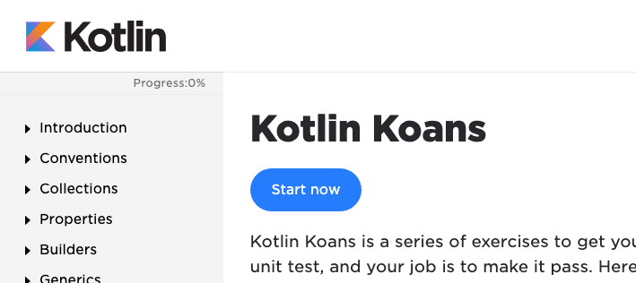

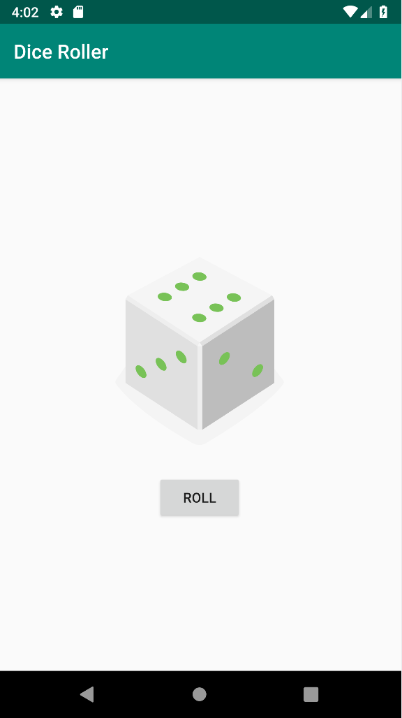
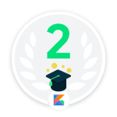
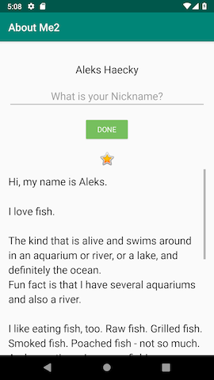
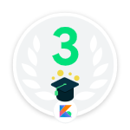
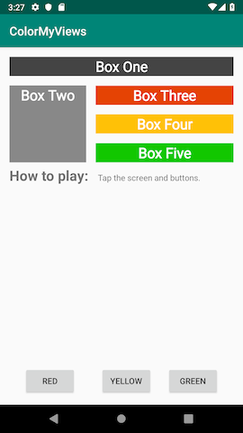
Prior Programming Experience Track
Badges
Earn badges
at the end of each
pathway!
What will you learn?
Pre-Work
Go through a series of exercises to become familiar with basic Kotlin language features.
(No badge
for pre-work)
Kotlin Koans
(2 hours)
1
Build your first app
Install and set up Android Studio, so you build your first "Hello, World!" Android app in Kotlin.
(0.5 hours)
Build an interactive app
Learn the basic anatomy of an Android app project, how to add images to your app, and how to enable backward compatibility of an app while creating a Dice Roller app.
2
(1 hours)
3
Layouts
Create different types of layouts, add user interactivity, and use data binding while creating two apps.
(1 hours)

Slide 10
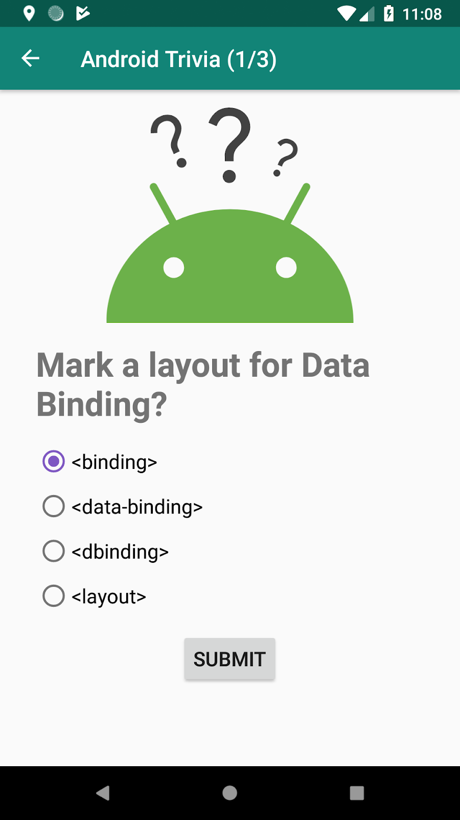
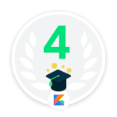
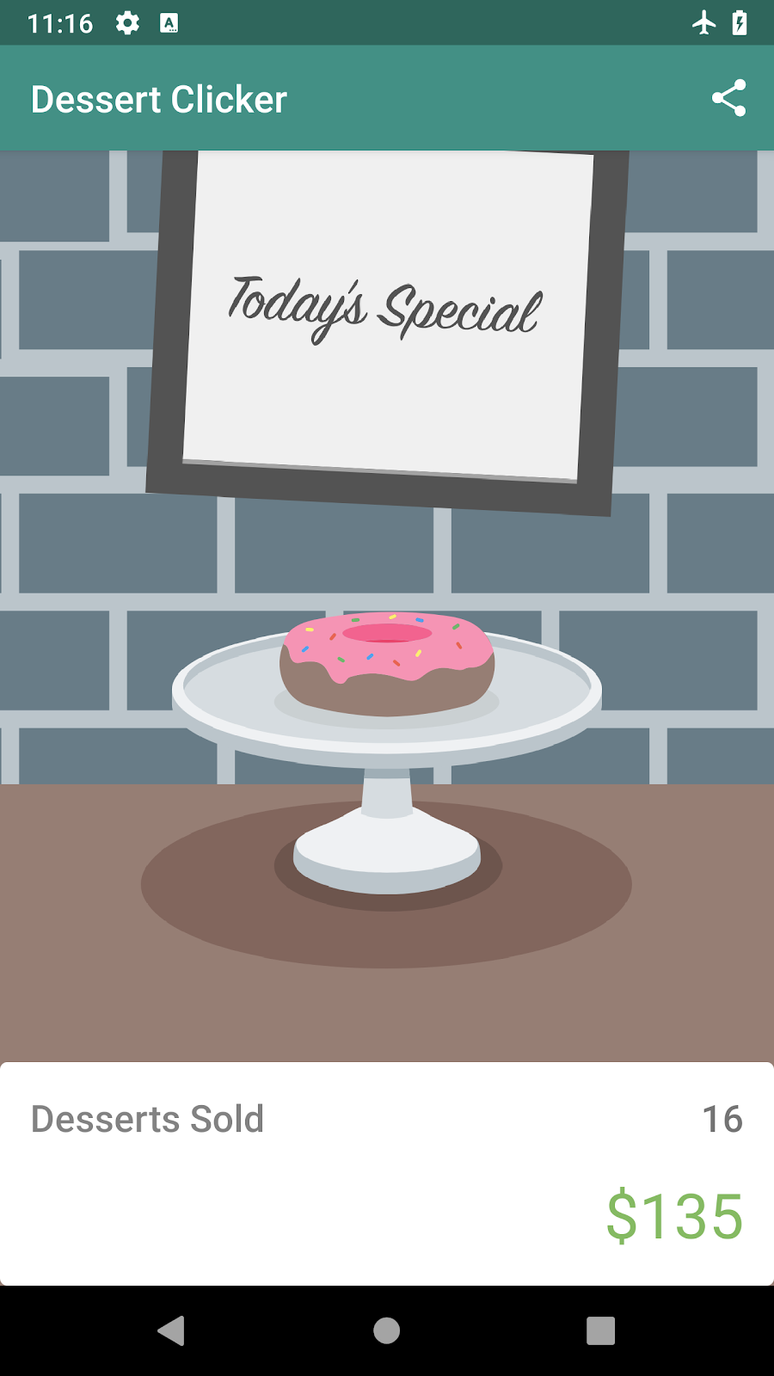

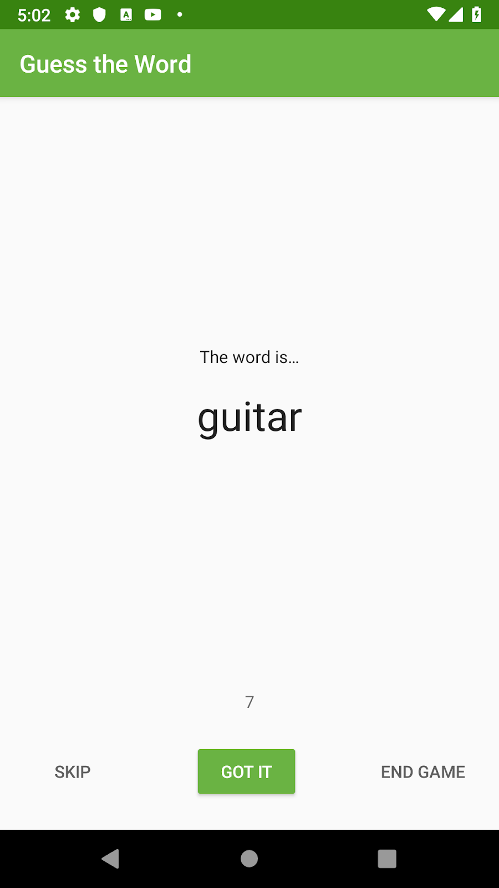

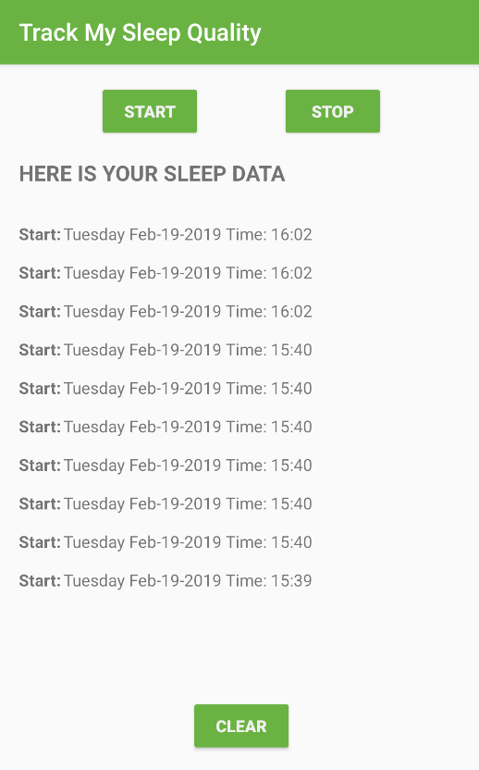

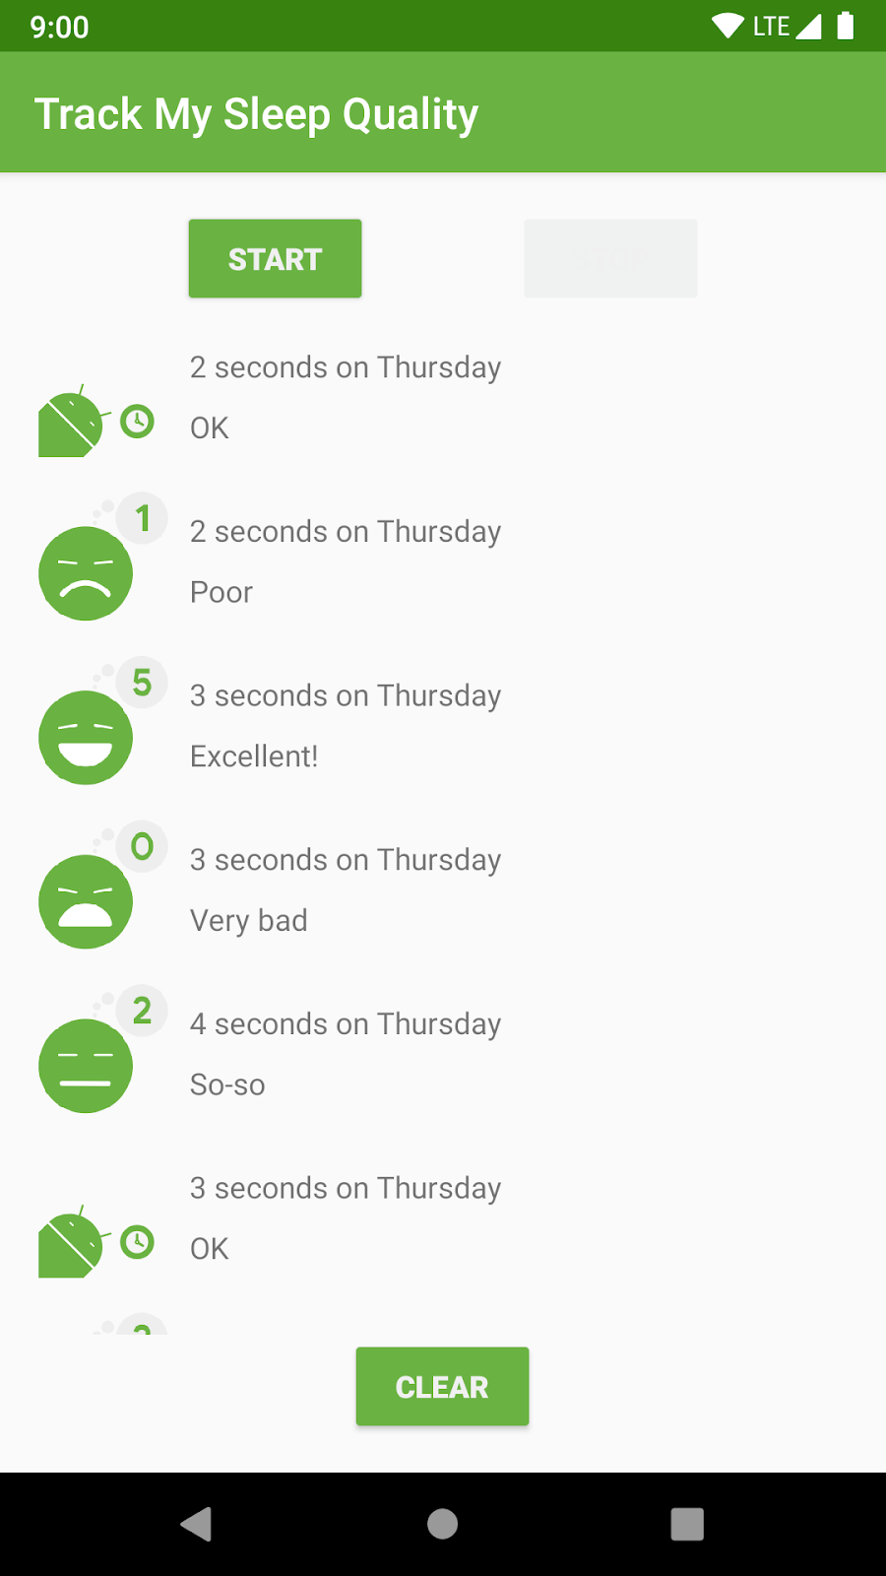
Prior Programming Experience Track
What will you learn?
Badges
Learn how multi-screen navigation works by creating a fragment, define navigation paths, and start an external activity through developing a trivia app.
4
Navigation
(3 hours)
Learn about Activity and Fragment lifecycles, how to handle complex lifecycle situations, and use logging to help debug and track the state of the app by creating the Dessert Clicker app that will preserve its state on rotation.
5
Activity and Fragment lifecycles
(2 hours)
Architecture components
Learn about ViewModel, LiveData, data binding with ViewModel and LiveData, and LiveData transformations by completing a charades game app.
6
(3 hours)
Databases and RecyclerView
Create a database using the Room library, use coroutines to simplify asynchronous programming, and display a list with RecyclerView in the TrackMySleep app.
7
(4 hours)

Slide 11
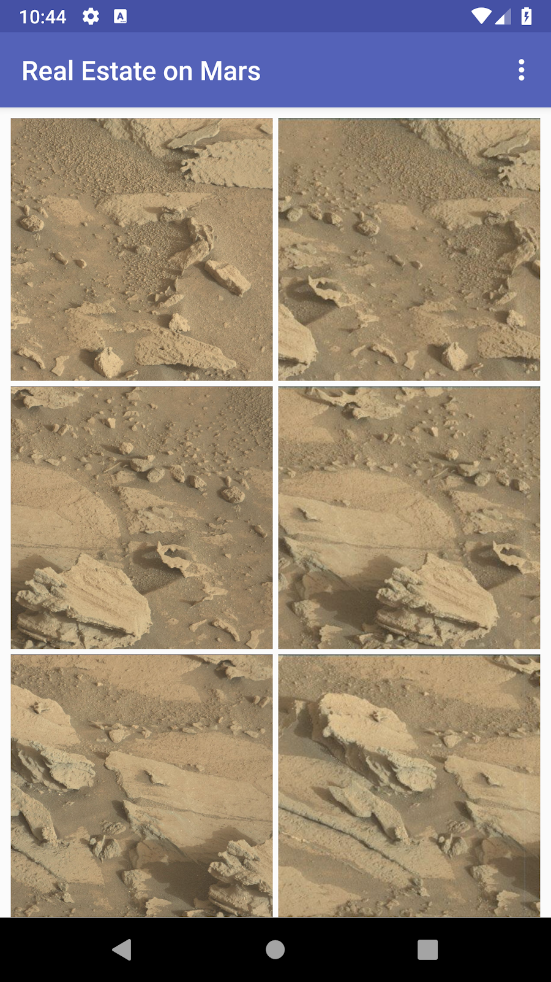
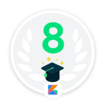
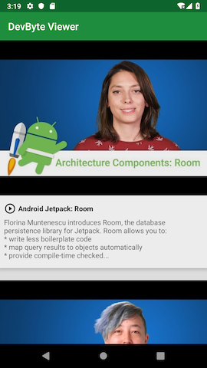



Prior Programming Experience Track
What will you learn?
Badges
Connect to the internet
Learn how to get data and images from the internet and display them in the app by developing a MarsRealEstate app.
8
(2 hours)
Create a repository, add an offline cache, and schedule background tasks with WorkManager by completing an app called DevBytes, handling background processes with best practices.
9
Repository and WorkManager
(2 hours)
Learn the basics of Android's styling system, how to apply Material Design principles to the UI of your app, and how to make your app more accessible for all users by creating a Google Developer Groups Finder app.
10
Design for everyone
(2 hours)

Slide 12
After I decide on a track, what should I do next?
Sessions can be hosted on a full weekend day, weekend days back-to-back, weekday nights, on a weekly basis, etc..
Choose how far in the course curriculum you want to go* (e.g., just the first few pathways or all pathways that are available?)
Look at the pathways you’ll be covering and the time estimates for each
Decide how many Android Study Jam sessions you will hold
(You can cover more than 1 pathway in a session, if your sessions are longer)
Select dates and times for these sessions
Session 1
Session 2
Session 1
Session 2
1
2
...
n
1
2
3
1
2
3
1
2
3
(2 hours)
(1 hours)
(3 hours)
(2 hours)
(1 hours)
(3 hours)
(2 hours)
(1 hours)
(3 hours)
 |  |  | x
 |  |  | x
*Pathways for a track should be completed in order, since the concepts build on each other.

Slide 13
Logistics
Tips on planning and
running a successful event

Slide 14
Before the Event
1
2
3
4
5
Find a Venue
Create the event
Prepare content
Plan agenda
Send pre-event message
First, find a location &
invite your community members.
If you can’t host the event in a physical location, review this guide on Hosting Virtual Events
Once you create the event, start promoting the event link so people can begin to RSVP.
You can use these marketing assets for promotion.
In preparation for the event, you’ll want to familiarize yourself and any co-speakers with the slides.
It’s important to plan an agenda and share it with co-organizers and attendees so everyone is on the same page.
Check out later slides for some sample agendas.
Before the event, it’s always good to send a pre-event message to explain any logistics and get your community excited for the event.
Example communications (new to programming, prior programming experience, social media)

Slide 15
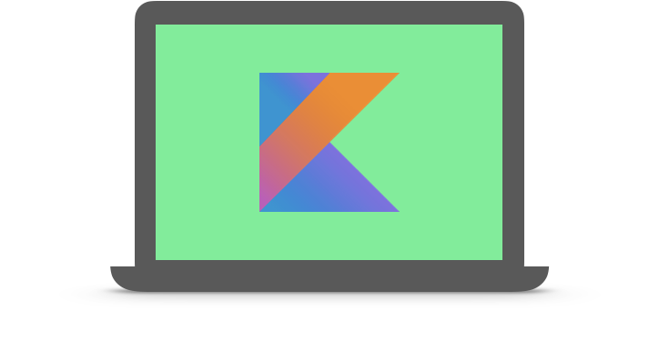
Equipment needed for each student
Computer
Meets these system requirements for installing Android Studio
With Android Studio installed*
Internet connection
(Optional) Android device & USB cable
* Either ask students to install Android Studio ahead of time before the session, or they will do this as part of the hands-on codelabs in the sessions.
Notes:
The decision to have attendees install Android Studio on their computers beforehand is up to your preference.
Option 1: You can have attendees install Android Studio as part of the hands-on codelabs. There are instructions within the two tracks for students to install Android Studio. This will take up more time during your session, but will allow them to ask questions if they need help with the install and set up process.
Option 2: You could ask attendees to install Android Studio on their own before attending a session. Just be sure to let them know that this is expected of them prior to the session. These instructions may be useful.

Slide 16

During the Event
1
2
3
4
Get the exclusive badge!
Have Fun!
Present deck
& content demos
Answer Questions
At the start of the first session of Android Study Jams, have attendees to go to g.co/android/studyjams. This will lead them to the landing page for Android Study Jams, where they will earn their exclusive Android Study Jams participant badge, which they can add to their Google Developer Profile.
You bring the energy to the session, so be sure to come energized and ready to have some fun!
Check out the tips on the next slide for running a fun and engaging event.
Present the materials that you prepared.
While everyone is working on pathways, make sure everyone you’re available for questions.
Feel free to check on people and ask them
how things are going, rather than wait for people to come to you.

Slide 17
Run a Fun and Engaging Event
Prepare Seed Questions
Use pre-prepared questions, or seed questions, to help keep engagement and discussion going.
You can collect them at the very beginning from participants to gauge their understanding and return to them later.
Make sure the entire room can hear you. Project while speaking or use a microphone.
Smile & have fun!

Slide 18
After the Event
1
2
3
4
Celebrate the end with attendees
Submit post-event survey
Share slides
with attendees
Gauge interest in more events
Your attendees have worked hard and learned a lot. They deserve to be celebrated, and
so do you!
Fill out the post-event survey so that Google can continuously improve this session.
You can find more information about the post-event survey here.
Attendees will want access to your deck after the session, so make sure to make a copy and send it out afterwards, or just post a short link at the end of the event.
This can act as a springboard for more Android Study Jam sessions or general Android meetups in your community -- don’t lose momentum!
Make sure people know where to look if they want to learn more.

Slide 19
Submit Post-Event Survey
If you have any specific feedback on the Android Study Jams content, fill out this form here! (Optional)
For Google developer communities (such as Developer Student Clubs and Google Developer Groups), please fill out the post-event survey form for each Android Study Jams session you organize through the event platform’s automated email. (Required)

Slide 20
Hosting Events Virtually
1
2
3
Create your event
Share the event
Record Event
Create your event on an event platform. For Google developer communities, create your event on the DSC/GDG event platform with a streaming link, or include a link for Google Meet, YouTube Live Stream, or whichever platform your community prefers; check out the online guidance for tips!
You can share the event page link with your community so they can learn more about the event and RSVP. Send out reminder emails for the upcoming event, if the event platform you’re using doesn’t already send them out.
Record the event. Let everyone know you'll be doing this before and at the start of the event. Share the recording afterwards so people have something to look back on.

Slide 21
Marketing
Sample templates and marketing assets to
help you share your event

Slide 22
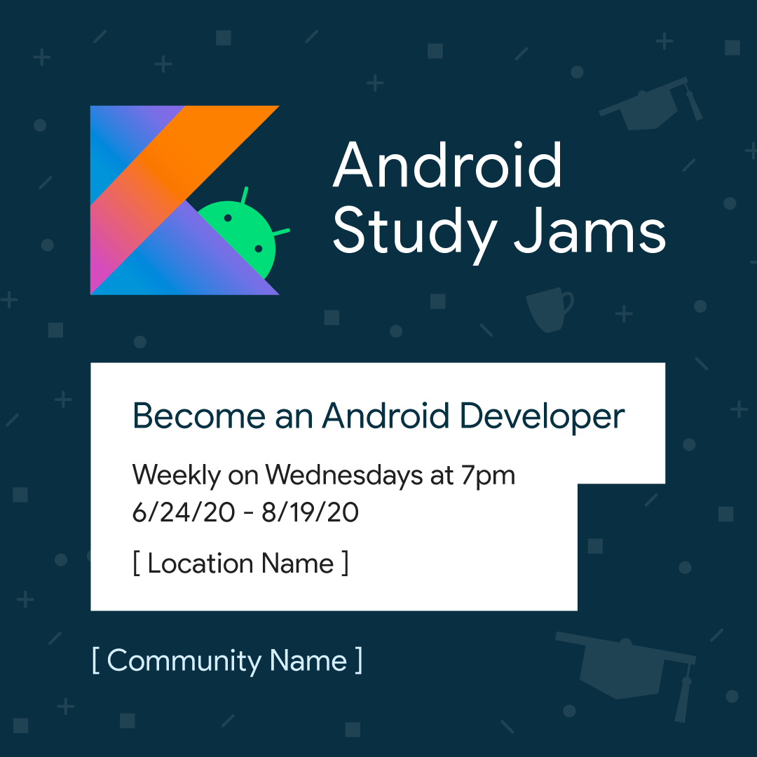
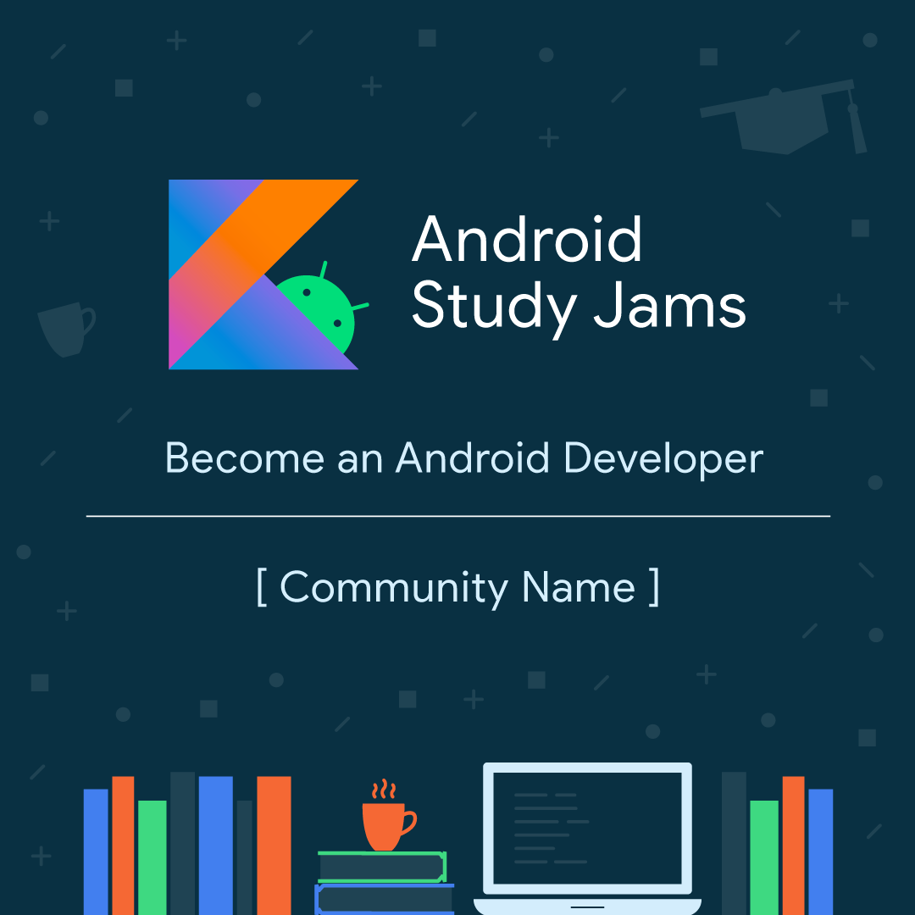
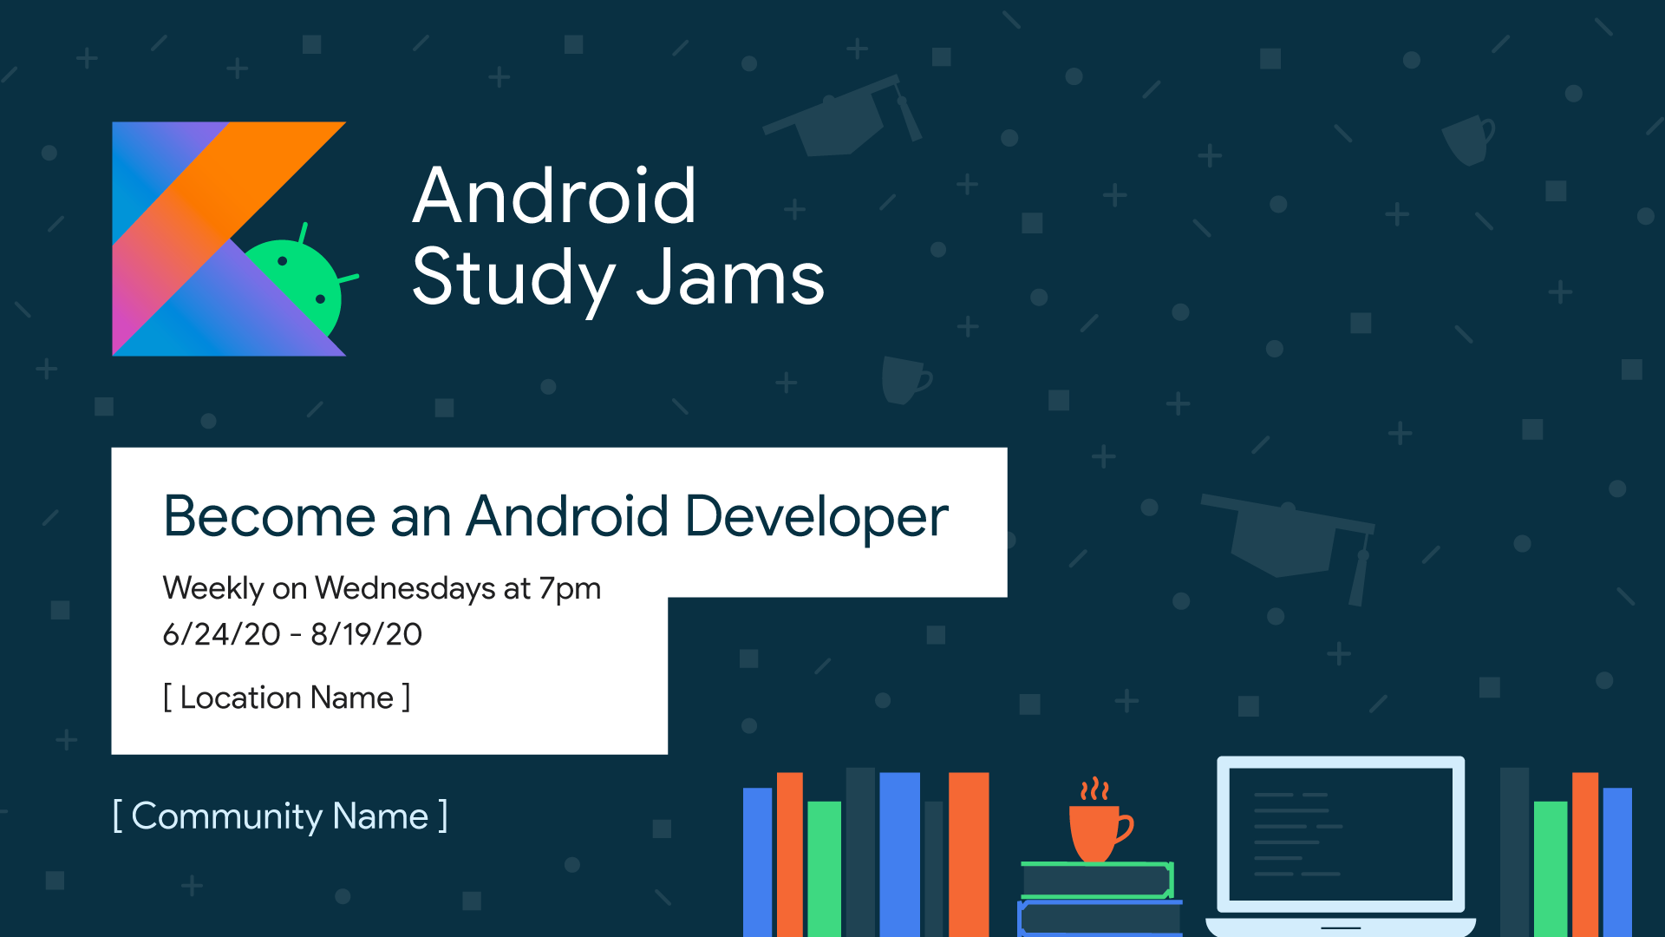
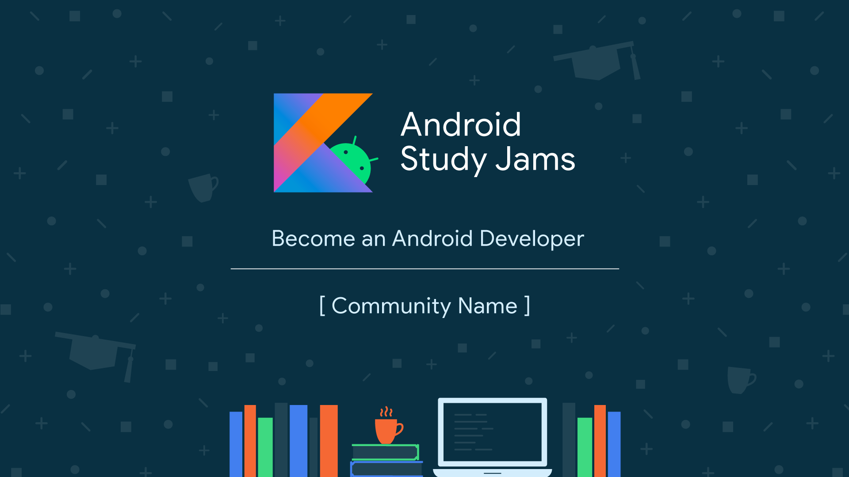
Social Media Assets
Marketing Assets Folder
Square
Wide

Slide 23
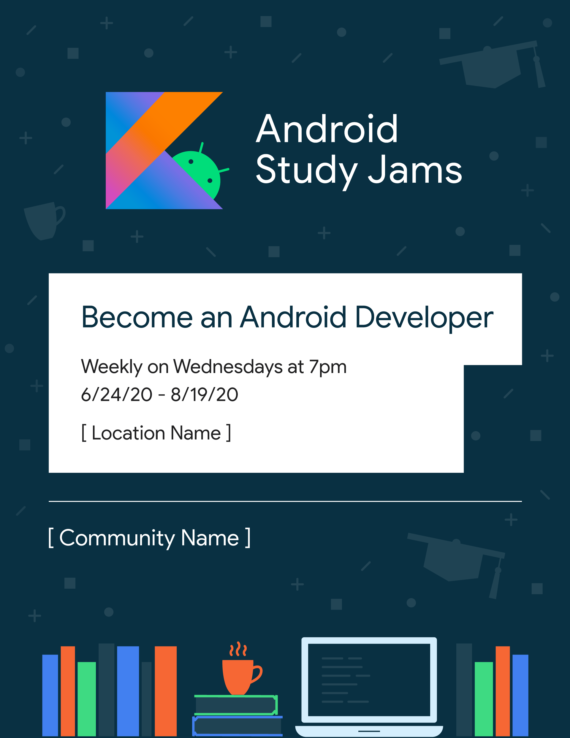
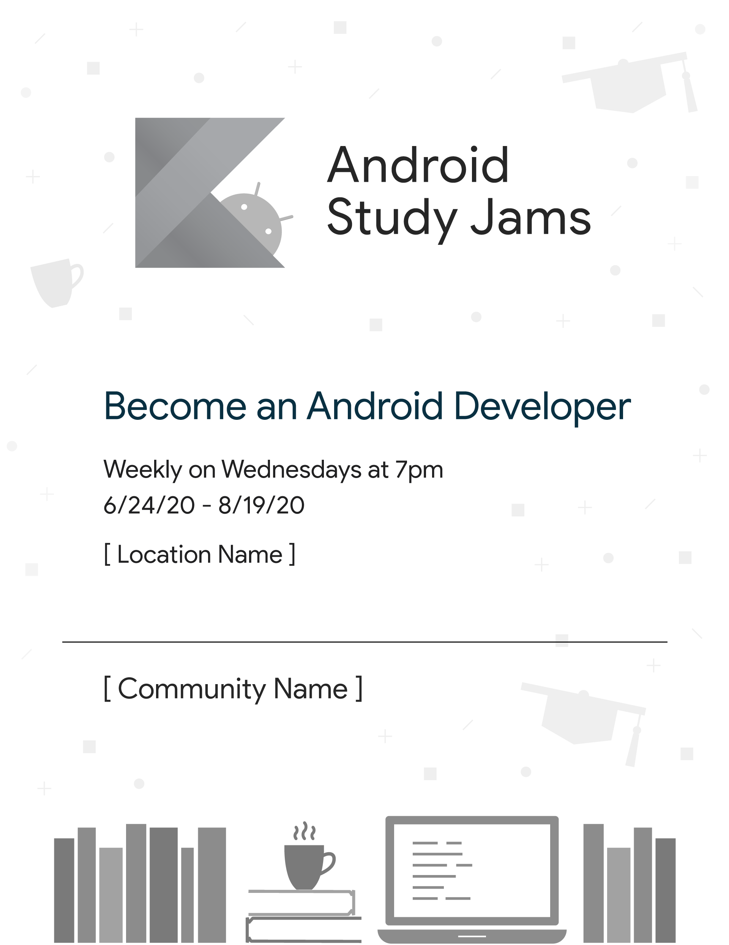
Flyers
Open in Google Slides

Slide 24
Sample Communications
Email Announcement for New to Programming Track
Hello <Insert Community Group Name>!
I’m excited to announce that we’ll soon be kicking off Android Study Jams for our chapter. This is an event series for people who are new to programming and interested in developing Android apps with the support of a study group. Starting on <Insert Date and Place>, we will be meeting <Insert duration such as “every Saturday for 6 weeks”> and working through a curriculum that is offered by Google on Android development. You’ll learn the basics of programming and how to apply those skills to building basic Android apps in the Kotlin programming language. By the end, you will have a collection of apps that you can customize as you desire.
All you need to bring is your laptop computer and headphones. <Either mention that their computer should meet the system requirements or ask them to install Android Studio ahead of time, if that’s your preference> Having an Android device is optional, but if you do have one, bring that with a USB cable so you can learn to run your apps on your device.
No programming experience is needed! Join us to advance your skills and learn how to build apps. Let me know if you have any questions and hope to see you soon.
Best,
<Community Lead> <Community Name>

Slide 25
Sample Communications
Email Announcement for Prior Programming Experience Track
Hello <Insert Community Group Name>!
I’m excited to announce that we’ll soon be kicking off Android Study Jams for our chapter. This is an event series for people who have prior programming experience and are interested in learning Android app development with the support of a study group.
Starting on <Insert Date and Place>, we will be meeting together to learn the essentials of the Kotlin programming language and the fundamentals of how to build Android apps in Kotlin. The first session is about ramping up on the Kotlin programming language, including syntax and basic language features. If you already know Kotlin, feel free to skip this session and join us for the second one on <Insert Date and Place>, where we’ll start diving into Android development with a curriculum offered by Google.
All you need to bring is your laptop computer. <Either mention that their computer should meet the system requirements or ask them to install Android Studio ahead of time, if that’s your preference> Having an Android device is optional, but if you do have one, bring that with a USB cable so you can learn to run your apps on your device.
The whole program lasts for <Insert duration>. Your knowledge will build on itself week over week as you build a collection of Android apps that showcase what you’ve learned. There’s never been a better time to learn Android development in Kotlin, so we hope to see you soon!
Best, <Community Lead> <Community Name>

Slide 26
Sample Communications
Social Media Posts
Use these hashtags: #AndroidStudyJams and your own community hashtag
Start your journey to become an Android developer by joining us for Android Study Jams! We’ll meet on <Insert Date & Location> for the first session.
Learn how to build Android apps as part of the Android Study Jams event series.
Android Study Jams are here! Join us on <Insert Date & Location> to learn how to build your first Android app.

Slide 27
Bonus Materials

Slide 28

Bonus Materials to help you run Android Study Jams
Android Study Jams Presenter Guide
[Attendee Slides] New to Programming Track Sessions 1 & 2
[Attendee Slides] Prior Programming Experience Track Sessions 1 & 2

Slide 29
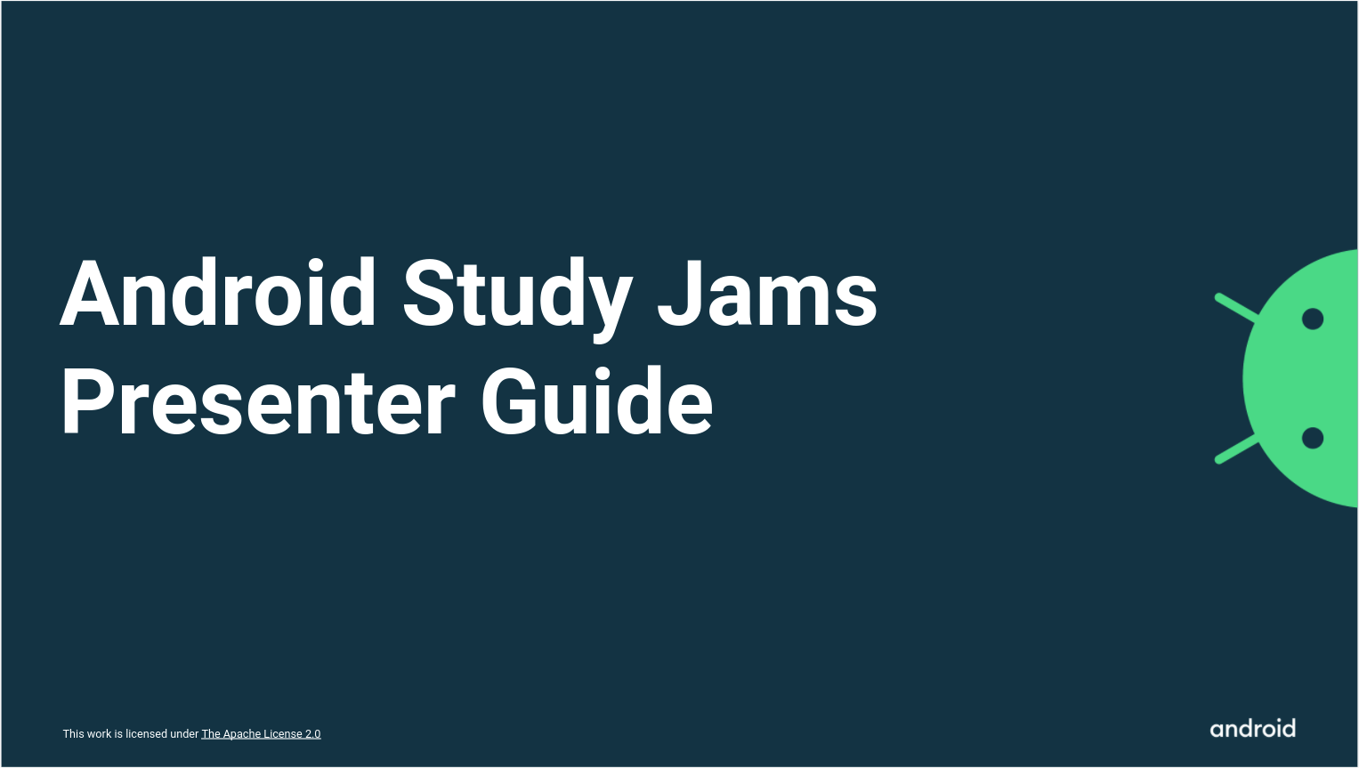
Android Study Jams Presenter Guide
Tips on the presenter role and how to engage your audience
Guidance on how to create your own attendee slides based on the curriculum

Slide 30
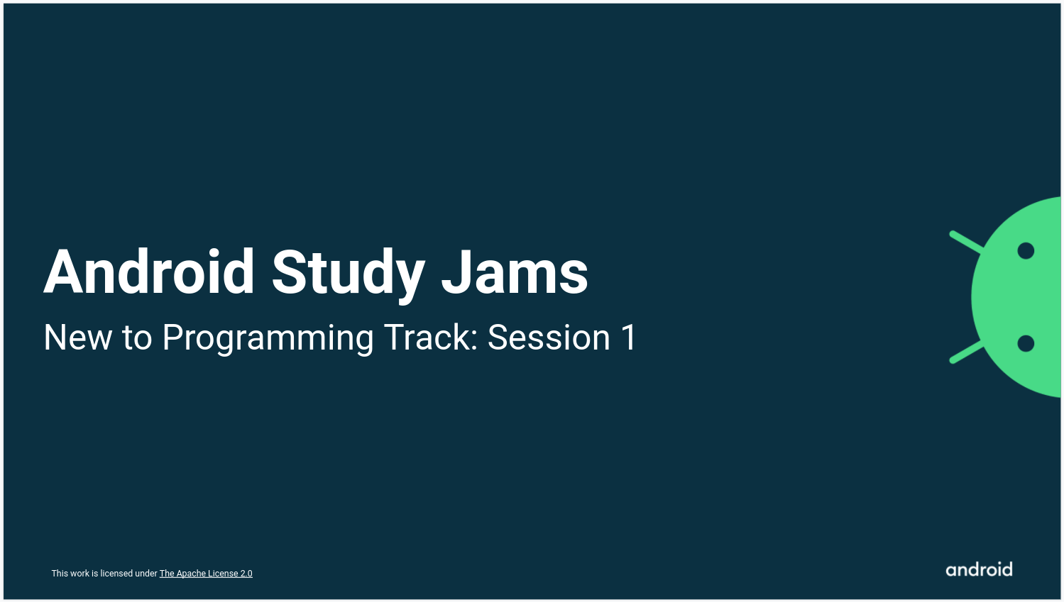
Sample Attendee Slides for
New to Programming Track
New to Programming Track Sessions 1 & 2
We’ve put together some sample attendee slides to help you get started with your New to Programming Track covering the first 4 pathways of the Android Basics in Kotlin Course. These were developed with the thought of sessions lasting three hours each.
Session 1 covers the first three pathways of Android Basics in Kotlin
Session 2 covers the fourth pathway
1
2
3
4

Slide 31
Sample Agendas for
New to Programming Track
Session 1
Session 2
TOPIC | TIME
Logistics & Concept Overview | 12:00 - 12:15
Pathway 1: Introduction to Kotlin | 12:15 - 1:15
Break | 1:15 - 1:30
Pathway 2: Create Your First Android App | 1:30 - 2:15
Pathway 3: Build a Basic Layout | 2:15 - 3:00
TOPIC | TIME
Logistics & Concept Overview | 12:00 - 12:15
Pathway 4: Add a button to an App | 12:15 - 1:00
Break | 1:00 - 1:15
Pathway 4 (continued) | 1:15 - 2:00
Break | 2:00 - 2:15
Pathway 4 (continued) | 2:15 - 3:00

Slide 32
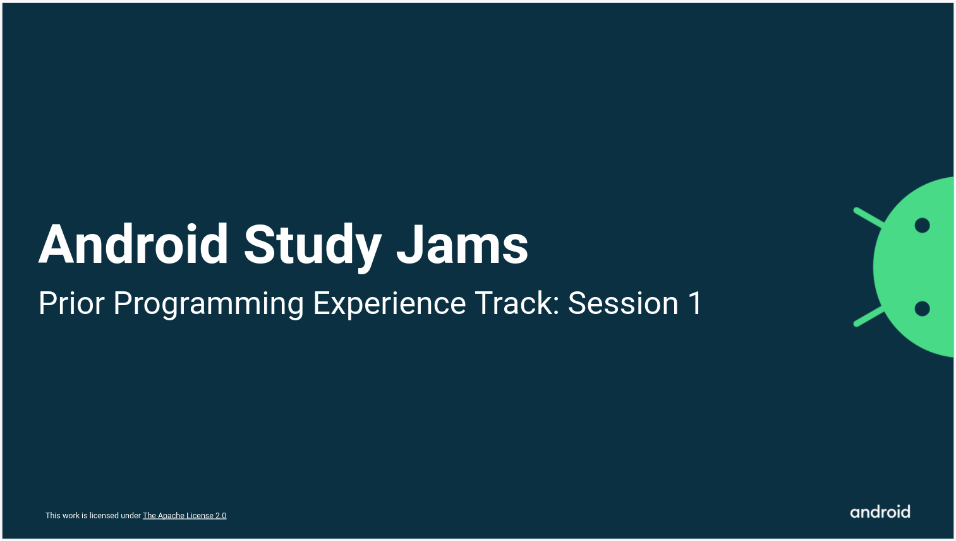

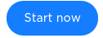
Sample Attendee Slides for
Prior Programming Experience Track
Prior Programming Experience Track Sessions 1 & 2
We’ve put together some supplementary material to help you get started with your Prior Programming Experience Track with the Android Kotlin Fundamentals course covering the initial steps of your journey. These were developed with the thought of sessions lasting two to three hours each.
Session 1 covers the pre-work with an introduction to Kotlin using Kotlin Koans
Session 2 covers the first three pathways of Android Kotlin Fundamentals
1
2
3

Slide 33
Sample Agendas for
Prior Programming Experience Track
Session 1
Session 2
TOPIC | TIME
Logistics & Concept Overview | 12:00 - 12:15
Kotlin Koans | 12:15 - 1:00
Break | 1:00 - 1:15
Kotlin Koans (continued) | 1:15 - 2:00
TOPIC | TIME
Logistics & Concept Overview | 12:00 - 12:15
Pathway 1: Build Your First App | 12:15 - 1:00
Break | 1:00 - 1:15
Pathway 2: Build an Interactive App | 1:15 - 2:00
Pathway 3: Layouts | 2:00 - 3:00

Slide 34

THANK YOU and have fun helping your communities become Android developers!
Version 1.0

